Slide 1
Ecommerce Sales & Profit Dashboard
Business Performance Analysis

Slide 2
Executive Summary
Strong overall performance with balanced sales and profit
Profit margin around 12% indicates moderate profitability
Stable year-over-year growth (0%) suggests stagnation
Sales driven by Technology and Office Supplies categories
Regional performance varies significantly

Slide 3
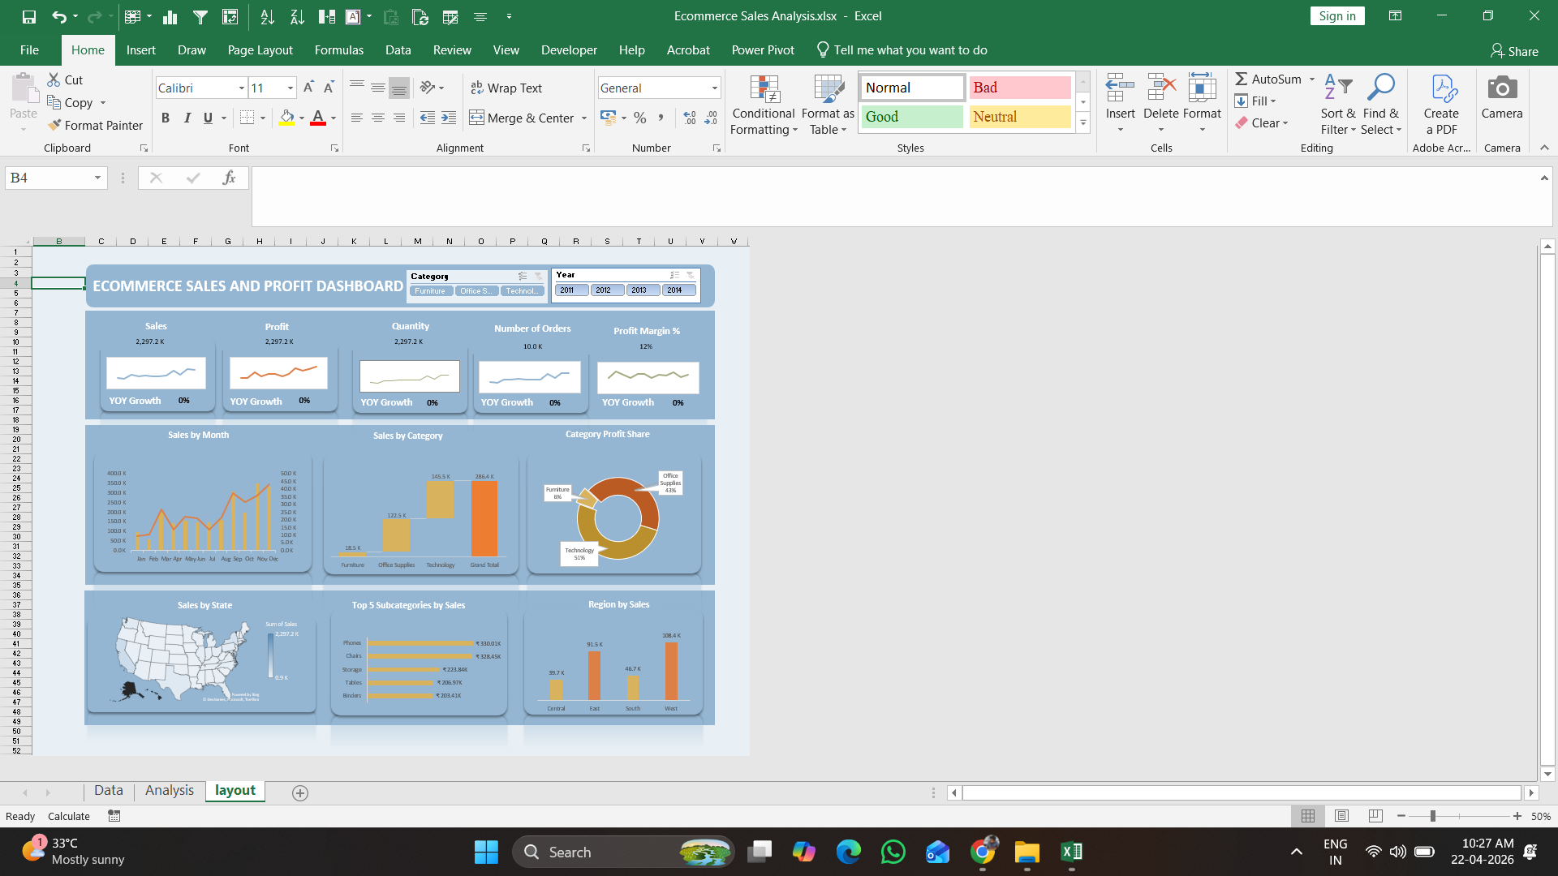
Dashboard Overview

Slide 4
Sales Insights
Monthly sales show fluctuations with peak towards year-end
Consistent growth trend but with seasonal dips
High contribution from Technology category
Total orders ~10K indicates strong demand

Slide 5
Profit Analysis
Profit margin at ~12% indicates room for improvement
Office Supplies contributes highest profit share (~43%)
Technology follows closely (~35%)
Furniture contributes least profit (~22%)

Slide 6
Regional Performance
West region leads in sales
East region shows strong performance
Central region underperforms
Opportunity to optimize low-performing regions

Slide 7
Recommendations
Improve profit margins via pricing optimization
Focus on high-performing categories (Technology)
Boost marketing in low-performing regions
Investigate stagnant YoY growth
Enhance customer retention strategies

